Slide 1
Title I Annual Meeting 2023-2024
James A. Webster Elementary School
Principal: Bethany Groves
Assistant Principals:
Danielle Coates,
LaShonda Watson

Slide 2
Agenda
Overview of Title I
Use of Title I Funds
Parental Rights
Accountability
Parental Involvement
School Parent Compact
Next Steps

Slide 3
About Title I
Title I is the largest federal assistance program for our nation’s schools.
The goal of Title I is to address the academic needs of students and to assist them in meeting their state’s academic standards.
The program serves 14 schools in St. Johns County including eligible students in 3 non-public schools.

Slide 4
Title I Funding
St. Johns County Schools
Increased Student Achievement
Federal Government
1
3
2
Webster Elementary School
Florida Department of Education
Notes:
The Florida Department of Education receives funds from the federal government. Districts receive Title I funds from Department of Education, and the school district distributes these funds to schools based on the percentage of children eligible for free/reduced price lunch; however, students do not have to be from low-income families to receive help.

Slide 5
Title I Supports Webster Elementary
We use these funds to provide:
Additional supplemental personnel
Classroom Teachers to keep class size low
Additional ESE teachers
Reading & Math Interventionists
Behavioral Support Staff
Additional Arts Enrichment
Extended Learning Opportunities like Tutoring
Summer Enrichment Camps
Supplemental teaching materials, equipment, and technology
Parent and Family Engagement Resources and Training Workshops

Slide 6
Title I Schoolwide Planning
First
Second
Last
Input from school, family, and community members determine how Title I funds are used based on a needs assessment.
Please attend meetings/trainings and complete surveys to provide input on Title I funding.
All Title I schools must document that parents are involved in the schoolwide planning process.

Slide 7
Working Together for Student Success
As a Title I parent you have the right to be involved in the development of the following plans and documents for our school which can be found on our website or available in print upon request.
School Improvement Plan (SIP)
School-Parent-Student Compact
Parent and Family Engagement Plan (PFEP)
Through School Advisory Council (SAC) and parent meetings
Notes:
Explain how you will invite families to provide input for required plans.

Slide 8
Parent’s Right to Know
As a parent of a student attending a St. Johns County Public School, you have the right to…
Be provided information on your child’s level of achievement on assessments in Reading/Language Arts, Writing, Mathematics, and Science.
Request and receive information on the qualifications of your child’s teacher and supplemental personnel working with your child.
Be notified if your child’s teacher is teaching out-of-field.
Be informed if your child is taught by a teachers who does not meet state certification or licensure requirements for four or more consecutive weeks.

Slide 9
Parent-School-Student Compact
The Parent-School-Student Compact is updated every year to include parent, student, teacher, and staff input. Parent, student, teacher and staff comments are welcome at any time during the year.
At the elementary school level, the compact is discussed during parent teacher conferences. A copy if provided tonight as well.
Notes:
The purpose of the compact is to foster student achievement. By signing the Parent-School-Student Compact, Enter School name Elementary, teachers, staff, parents and students agree to work together to share the responsibility of helping students meet or exceed state, district and school academic goals.

Slide 10
Parent and Family Engagement Plan (PFEP)
Describes how the school will carry out the parental engagement requirements
Developed jointly with parents
Title I schools must:
Provide information on how the school works with parents, community, volunteers, and business partnerships to increase student achievement
Provide trainings to staff on effective strategies to engage parents in their children’s education
Provide academic parent trainings designed to increase student achievement
Explain the curriculum, assessments, and the minimum standards that students are required to meet
Notes:
Provide information on the specific committees that parents can be involved. Include the purpose, date and time of meetings.
Explain the PFEP and its purpose.

Slide 11
Accountability
School Report Cards
School Grade and Overview
Population and Enrollment
Assessments – Academic Achievement, Growth, and Population
Assessments – English Language Learners
Graduation and Beyond
Educator Qualifications and Equity
Long-Term Goals and Interim Progress
Accelerated Course Enrollment
Per-Pupil Expenditures
National Data
Available online at https://edudata.fldoe.org/ or by request.

Slide 12
School Data
On the State's New Florida Assessment of Student Thinking (FAST)
ELA MATH
3rd grade 45% 51%
4th grade 44% 55%
5th grade 52% 58%

Slide 13
Florida’s academic content standards establish high expectations for all students.
Florida Standards identify what your child needs to know and be able to do in all content areas. You may read more information by visiting fldoe.org/academic/standards/.
Your child’s teacher will explain the standards for your child’s grade level during Curriculum Night.
Notes:
All curriculum, instruction and assessments are based on Floirda standards.

Slide 14
Assessments
FAST Test – PM 1, PM 2, and PM 3
BAS – Reading levels (alphabet)
Dibels – Fluency rate
Common District Assessments in Reading and Math as well as unit tests from the curriculum

Slide 15
Working Together for Student Success
Please join us…
October 1 – ELKS LODGE – Jeepers Creepers Fundraiser for Webster 11 AM – 4 PM
Food trucks, Jeeps, live Band, vendors, FUN
October 13th – 5:30 – 7:00 –
WEBSTER PTO
FALL FESTIVAL!!!
Parent/Teacher Conferences middle of October
Notes:
Add scheduled Quarter I family events

Slide 16
Next Steps
We encourage
you to…
stay involved through joining SAC, PTO, or volunteering.
communicate with the teachers and other
staff regularly.
participate in giving your input for our SIP, PFEP, and Compact.

Slide 17
Stay Connected With Us!
Important information from your child’s teacher will be shared on Class DOJO.
Be sure to watch emails and DOJO for event updates and school happenings
Visit our school website for up to date information.
Notes:
Update content based on your school means of communication

Slide 18
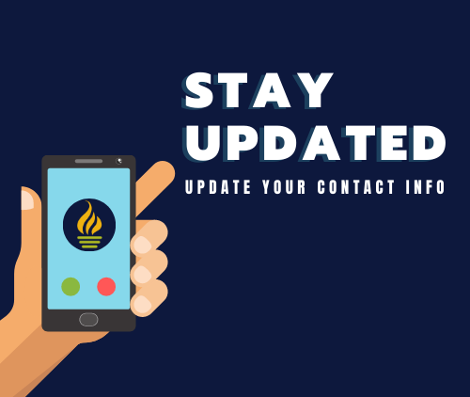
Please ensure that your current contact information is on file to stay informed about what’s occurring at your child’s school and in the district. Parents and guardians can receive phone calls, emails and text messages.

Slide 19
Thank You
Bethany Groves, Principal
904-547-3860
Bethany.groves@stjohns.k12.fl.us
Notes:
Personalize with contact information with Title I representative

